Slide 1
WHY IS CTEOS IMPORTANT? College Marketing Tools & Increasing Response Rates

Slide 2
YOUR PRESENTERS
Name
Name
Name
Notes:
Welcome: Add your name, title, and organization in the chat
Introductions

Slide 3
AGENDA
TODAY: WHAT & WHY
CTEOS Background & Purpose
What is the Data Used For?
Accessing the Data
TOMORROW: HOW
Communicating to Faculty and Administration
Marketing CTEOS
Notes:
Today we are covering the WHAT and the WHY in order to set the stage for the HOW, which we will cover in the next session on Nov. 6th. The November 6th workshop will be more interactive (insert teasers)
We will have different spots for questions throughout, please feel free to add them to the chat during the presentation and we will address them

Slide 4
Zoom Poll
Notes:
How much do you know about the CTEOS? A Lot, Some, A little, Nada

Slide 5
CTEOS Quick Facts
“Career Technical Education Employment Outcomes Survey”
Annual Survey
~120 Community Colleges currently participating, including non-credit institutions
Underwritten by the Chancellor’s Office, Managed by SRJC OIR
~150,000 former community college students surveyed every year
An average of ~30% participate annually
Notes:
120 – Including noncredit colleges

Slide 6
IN 2012 A PARTNERSHIP WAS BORN…
Piloted with fifteen California Community Colleges in 2012
2013 - 35 Colleges
2014 - 37 Colleges
2015 - 37 Colleges
2016 - 68 Colleges
Chancellor’s Office Underwriting for All CA Community Colleges
2017 - 116 Colleges
2018 - 117 Colleges
2019 - 117 Colleges
Non-Credit Colleges Added in 2020 + COVID Impacts Survey
Notes:
Collaborative effort among community college consortia, the Chancellor’s Office, the RP Group, and Santa Rosa Junior College
Modeled primarily after Cabrillo College’s Completer/Leaver Surveys
Practitioner-Driven Effort
Statewide meetings, conference calls, collaboration
All methodology, implementation and survey questions vetted
Use survey to collect data and information not available elsewhere
Report format developed in response to practitioner needs
Dual purposes:
Provide insightful information for local program improvement
Collect statewide data for documentation of CTE outcomes

Slide 7
THE BIG QUESTIONS…
Are our CTE students employable?
Do they find jobs in the field in which we trained them?
Do they see an increase in income?
In other words…
Was the program worth it? Are we justified in offering it?
Notes:
No data sources at that time
CCCCCO wanted to see degrees and transfers

Slide 8
How?
~1.5 - 2 years after the students stop attending
Transfer, graduate, license/award, or stop taking classes
Send them the survey that includes questions about:
Satisfaction with their CTE program or courses
Pre- and Post-education wages
Employment hours & length of time to find a job
Apprenticeship & Internship Statuses
Working within their field of study...
Survey Instrument at cteos.santarosa.edu

Slide 9
WHO RECEIVES THE SURVEY?
COMPLETERS | TERMINAL CERTIFICATES | SKILLS BUILDERS
CTE Degree | CTE Award of at least 6+ Units | 9+ CTE Units
CCCCO Approved Certificates | Not CCCCO Approved and not enrolled the following year | Have not received an award and are not enrolled in the following year
Notes:
Survey conducted approximately 1.5 years after completing/leaving
Completers:
Students who received a vocational/CTE award that is Chancellor’s Office approved and are not enrolled or are minimally enrolled each semester the following year.
Terminal Certificates:
Students who received a vocational/CTE award of at least 6 units that is not Chancellor’s Office approved and are not enrolled the following year.
Skills Builders:
Students who completed 9 units that are SAM coded and
have not received an award, and are not enrolled the
following year.

Slide 10
THE CTEOS ANNUAL PROCESS
October
November
December
January
Colleges provide primary & secondary contact information
COMIS provides data file of MIS data elements to OIR
OIR provides cohort lists to colleges to extract student contact info
Colleges provide student contact info
Notes:
The CTEOS works on an annual cycle
Starts in October with the Chancellors office and OIR reaching out to colleges to provide their primary contact info
Ends in September with the college reports and data sets being delivered to the Chancellor and schools
Actual surveying runs approx. 6-7 months out of the year

Slide 11
SURVEY DISTRIBUTION
Email
Text
Phone
Notes:
Survey Distribution
3 Modalities: e-mail 10-11%, then text 3-4% , then phone calls
Survey conducted approximately 1.5 years after completing/leaving

Slide 12
THE CTEOS ANNUAL PROCESS
February
August
September
OIR completes email and text surveys
Phone surveys complete
College reports & data sets complete
Complete data file to CCCCO

Slide 13
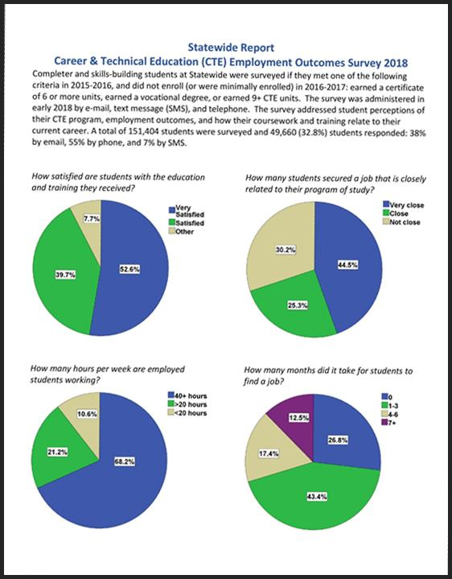
The Results:
Statewide Report
College Reports
Data Visualizations
Raw data is available to colleges by request

Slide 14
Data Elements Include:
College Attended
Demographics
Ed Goals
Units Earned
GPA
Program of Study
Apprenticeship and Internship
Satisfaction with Education/Training Received
Transfer status
Top Code of Awards
Local Certificate Names
Name of Certificate or License Earned
Employment Status
Current Job Title
How long it took to find a job
Wages before and after schooling
Zip code of current employment
SOC Codes
ONET Codes

Slide 15
Demographics Include:
Gender
Ethnicity
Age at time of school completion
DSPS
Military Status
Foster Youth Status
Incarcerated Status
Parent Education Level
Migrant Worker Status
Academically Disadvantaged…

Slide 16
Questions?

Slide 17
Zoom Poll
Notes:
What is your primary role at your institution?
Researcher
College/District Administrator
CTE Dept
Faculty
Classified Professional
Communications Dept
Consultant
Other roles

Slide 18
Why CTEOS?

Slide 19
What is CTEOS Data Used For By The State?
Strong Workforce Funding
Student Success Metrics
Vision for Success Goals
Notes:
For the state of California, CTEOS is mainly used for evaluating the number of students who are Employed in their Field of Study This metric is aligned in three different areas:
Strong Workforce Funding – It is a component the ⅓ incentive funding. This funding is based on the percentage of respondents who said that their job is Very Close or Close to their Field of Study against the number of students surveyed. Points are given for this number..
SS Metrics - To provide a holistic approach to the California community colleges’ work on student success, the Chancellor’s Office worked with a broadly representative group of practitioners to develop Student Success Metrics. Employment
Vision for Success – (Do you know which goal it is?) Goal #4: Over five years, increase the percent of exiting CTE students who report being employed in their field of study, from the most recent statewide average of 60 percent to an improved rate of 76 percent. (MORE: the average among the quintile of colleges showing the strongest performance on this measure and ensure the median earning gains of the exiting students are at least twice the statewide consumer price index. Improvements on this measure would indicate that colleges are providing career education programs that prepare students for available jobs and offering supports that help students find jobs.)
For those who have not accessed the data in Launchboard or CTOES we will have time at the end of this webinar to show you how to access the various sites.

Slide 20
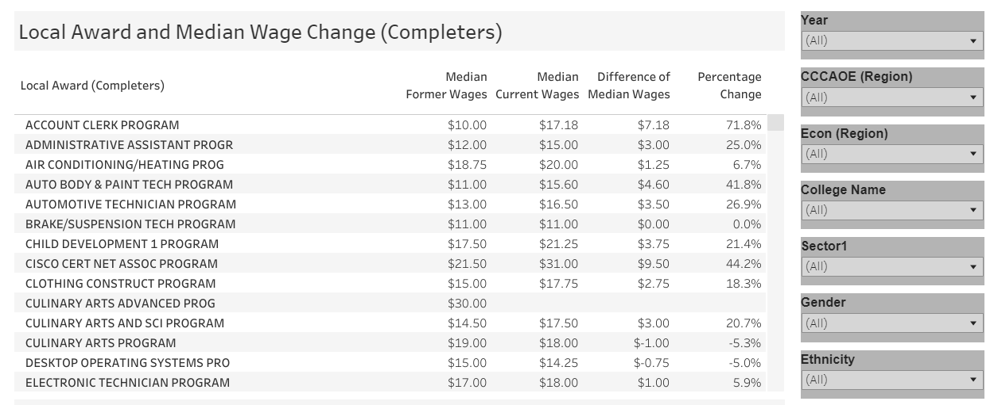
Example of Data from CTEOS Dashboard
Notes:
So now we understand the reasons, let’s take a look at some data examples to further dig into our own WHY for CTEOS.
Beginning to explore the data, here is a snapshot data of the entire state by award. You can see how, on the right hand side the data can be disaggregated by different categories.
You can begin to think about how you currently and potentially could utilize this data. You are welcome to put your thoughts in the chat.

Slide 21
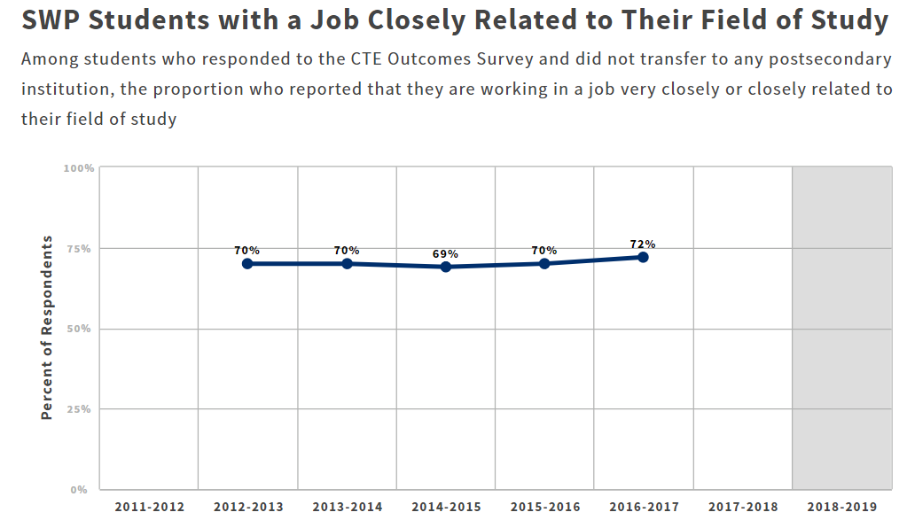
Example of LaunchBoard Data
Notes:
In Launchboard – the data from CTEOS is displayed in this manner. How would you utilize this data? Please put comments in the chat.

Slide 22
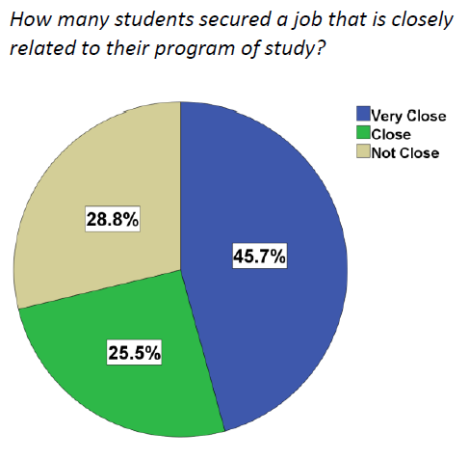
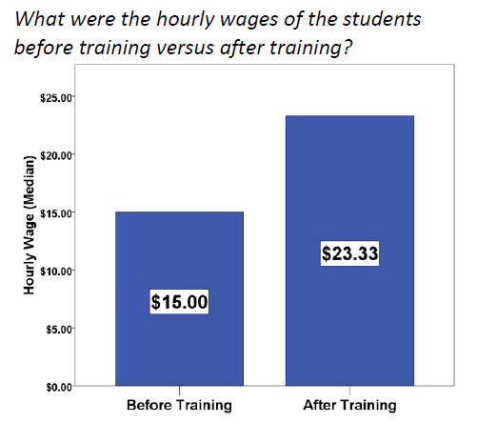
Sample CTEOS Data
Notes:
CTEOS also provides summary data by college and state that is easy to display and understand.
This example is the summary data from the entire state.
We can showing the work we are doing and how it is impacting the economy.
We can also get very powerful data, for example the wage gains before and after training.
Can you imagine showing this to a prospective student and their family?

Slide 23
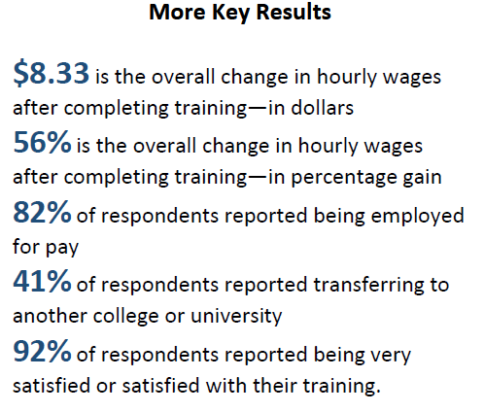
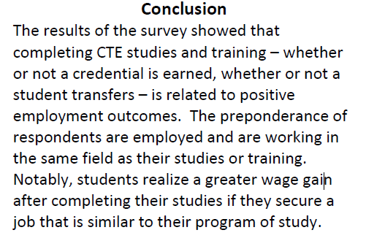
Summary CTEOS Data Sample
Notes:
Summary data of what CTEOS provides
CTEOS provides a summary conclusion in reports to your campus.
Again, how do you think you could use this data, please put comments in the chat.

Slide 24
How do you think you could use this data at your college? Please open your mic and/or put your response in the chat.

Slide 25
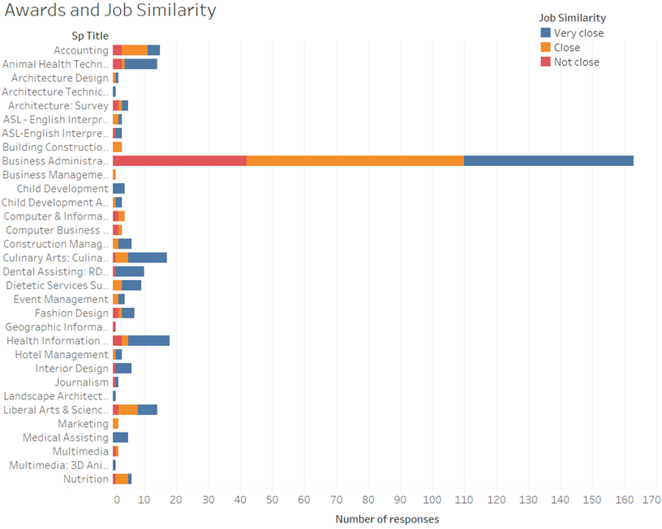
Limitations….
Notes:
So now we are sharing some college level data and we start to see some of the limitations of the data.
This graph this represents awards to job similarity (meaning how close to the program was to the job)
Business Administration had a lot of respondents, this is great data!!
All others awards are have under 20 respondents. Without a larger set of data from individual programs, how confident are we in the data, And would we want to share this data as representing our program?
Reflection: Because of the small sample sizes, when we go down to the program level, I am hesitant to share this with faculty, students and the community and here is why…

Slide 26
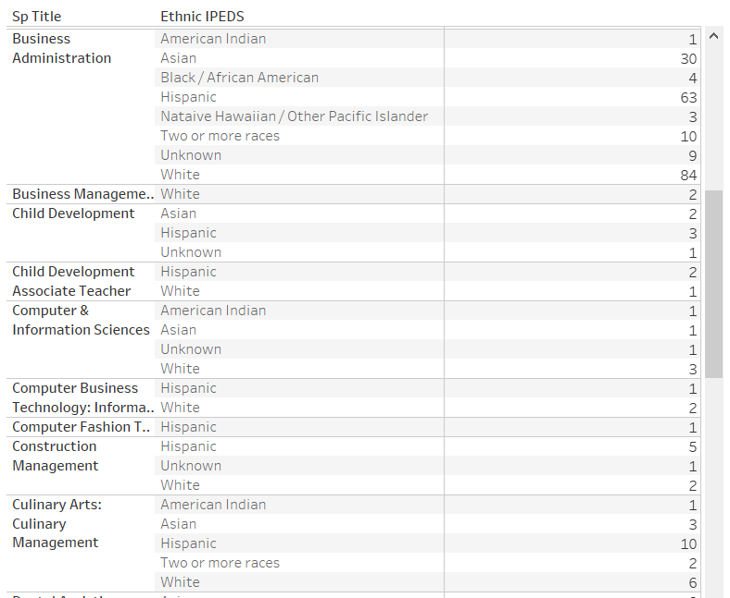
Frustrations...
Notes:
It is frustrating in this time of diving deep into issues of equity, that we cannot provide a breakdown of race and ethnicity, by programs.
In this example, you can see the Business Administration, which had 120 respondents, has a large enough sample size in most ethnic categories to break down the data and have some useful analysis. But you can see in many of the other programs, the sample size is to small to share and analyze.
Rule of thumb, if less than 10 you can start to identify students.
And to note - this is four years of CTEOS data for this college.
We need to improve the number of students responding in order to get more usable data.

Slide 27
Revelations...
Notes:
But at the same time there are some revelations.
This was put together by our campus researcher using raw CTEOS data, which can be requested
This is a visualization of where students were living when they took the survey… we found that is was fascinating how many were out of state!
This is for a San Diego Community College and we can see how many students were out of the region, the purpose of SWP is for the CA economy. We found for this particular college, that 11% were out of state. Also noting that if 11% were out of state, the wage data we are utilizing is reflective of the area they live in. An area with lower cost of living, the wage may be comparable, but when it is included in the overall data for a college or program, it may influence the numbers in a positive or negative way.
If we remove the responses from out of state, our in state data set becomes smaller, and even harder to disaggregate for any value.
You could remove all the data from out of your region to see a clearer picture, but again the numbers may become to small.
Looking at the overall data, there are a lot of influencers that will affect the regional data.

Slide 28
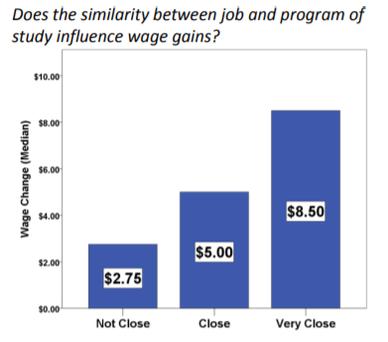
Revelations…
Notes:
And the revelations continue! In this state-wide sample form 2019 data - you can see the impact of wage gains when the job is close and very close to their program of study.

Slide 29
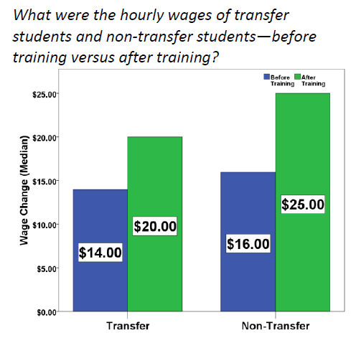
Transfer
Notes:
And we don’t want to forget about transfer, there is a lot of other data sources for transfer (UC, CSU, national clearing house), but data like this can show the value of a Career Ed program for both transfer and non transfer student.
But noting again, smaller data sets mean we cannot dig down past this level (yet).
We need more respondents to CTEOS - we need to market better!
Note: Transfer students are typically still in school, while our non-transfer students are entering or continuing in their career field.

Slide 30
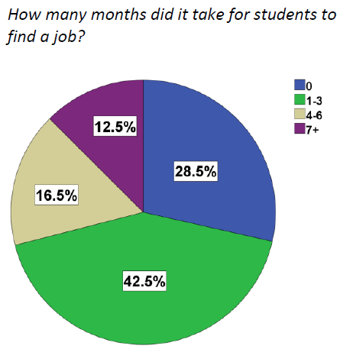
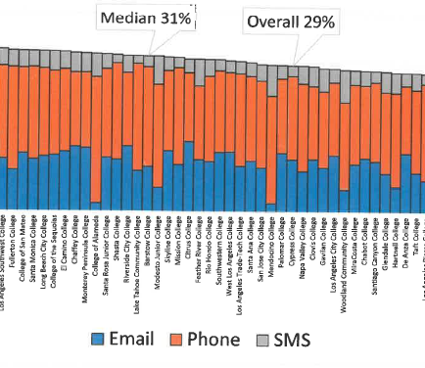
Areas for Improvement
Notes:
We have talked briefly about how you can use this data, the limitations, frustrations, and revelations. And what we clearly see if that we need more responses!!
The first image is a snapshot of the response rates for the 2019 CTEOS survey, the median rate is 31% and the Overall is 29%. While this is great in the survey world - we need more.
Considering the sample size you are surveying, if your college only has 500 students to survey, 30% is only 150 students. There is not a lot of ways to break down the data. It’s not as impactful as it could be.
In the second example, “How many months did it take for a student to find a job?” I think we all agree that more than 3 months could be critical to a student. However, we do not have enough respondents to dig deeper and find out who they are, what industries and how we can improve this outcome.

Slide 31
Funding Requests & Reporting
Program Review
Resource Allocation Requests
ACCJC and Specialized Accreditation
What else?
Notes:
And… How else can we use this data besides recruiting for students and employers?
In your campus program review process?
In Strong Workforce Funding proposals?
Perkins is looking at disaggregated data a lot more beyond race, gender.
ACCJC and our specialized accreditations need to show how well our students are succeeding
Open your mic or throw in the Chat how else this data can be used and where on your campus can you use CTEOS?

Slide 32
Questions?

Slide 33
To Do…
Head to santarosa.edu/CTEOS to find your data, college reports and review the visualizations
Do you know if your college puts out any communications regarding the CTEOS to students or faculty?
Does your college communicate to alumni about the survey and encourage their participation?
Does your college have any structure in place to make sure students’ contact information is current when they leave?
Is there a general culture of participation at your college?

Slide 34
Accessing your Data
CTEOS College Reports
https://cteos.santarosa.edu/college-reports
CTEOS - Visualizations
https://cteos.santarosa.edu/visualizations
Launchboard - Strong Workforce
https://www.calpassplus.org/LaunchBoard/Home.aspx

